Slide 1


Welcome to ISD Group
ACM – Milling edge grooves and sheetmetal in HiCAD

Slide 2



Workflow rear-ventilated facades
CAD software
HiCAD
Product Data Management
HELiOS

Slide 3
Options in sheetmetal when working with ACM

Slide 4
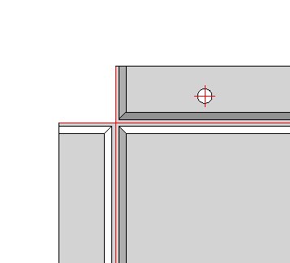
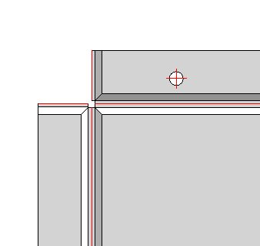
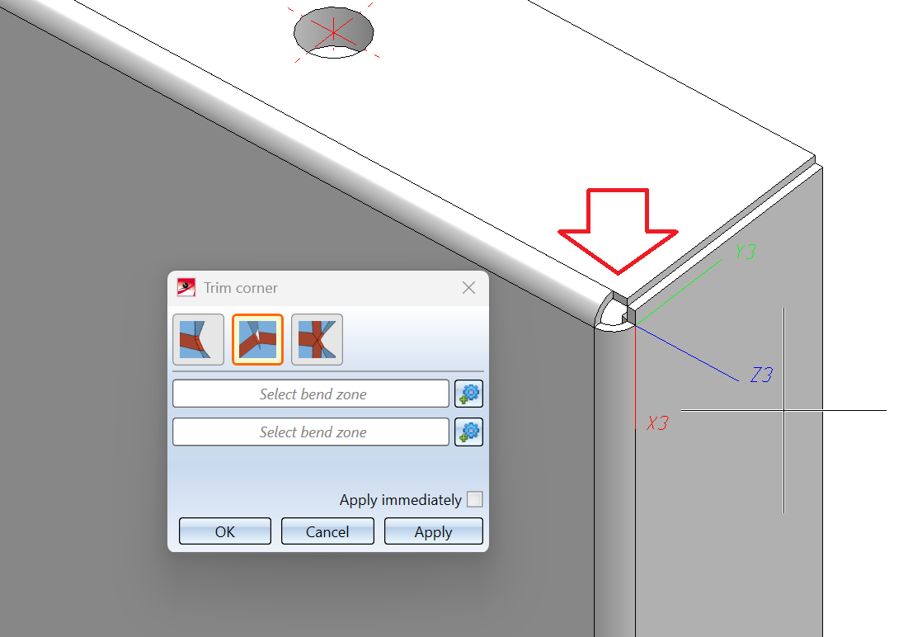
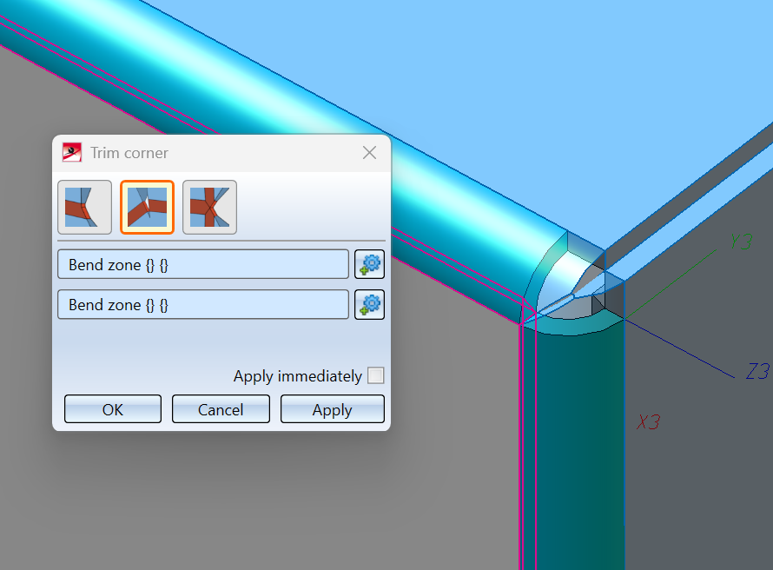
Sheetmetal and ACM: processes in detail: corners

Slide 5
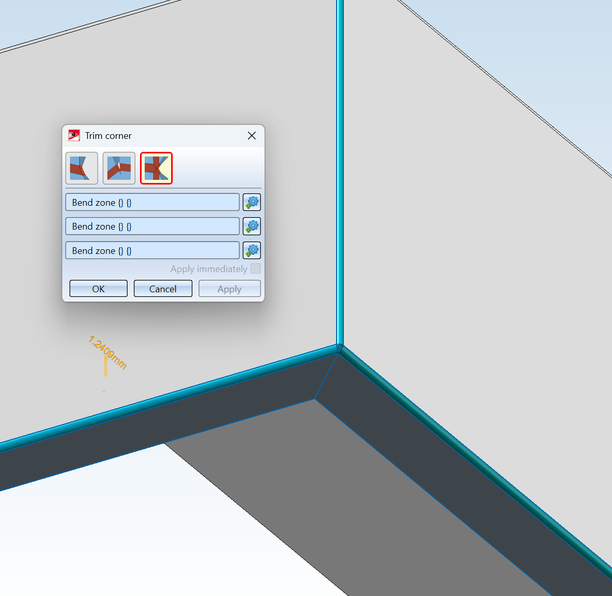
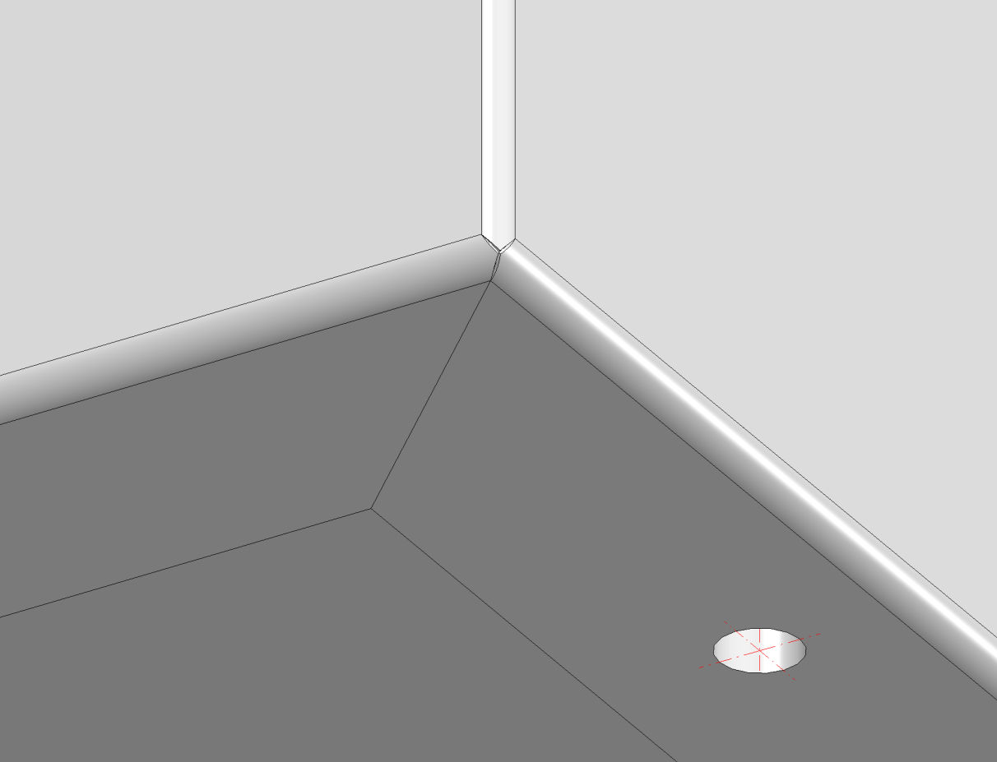
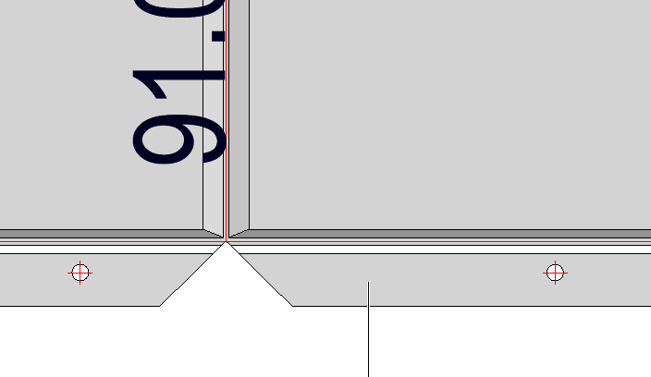
Sheetmetal and ACM: processes in detail: corners

Slide 6
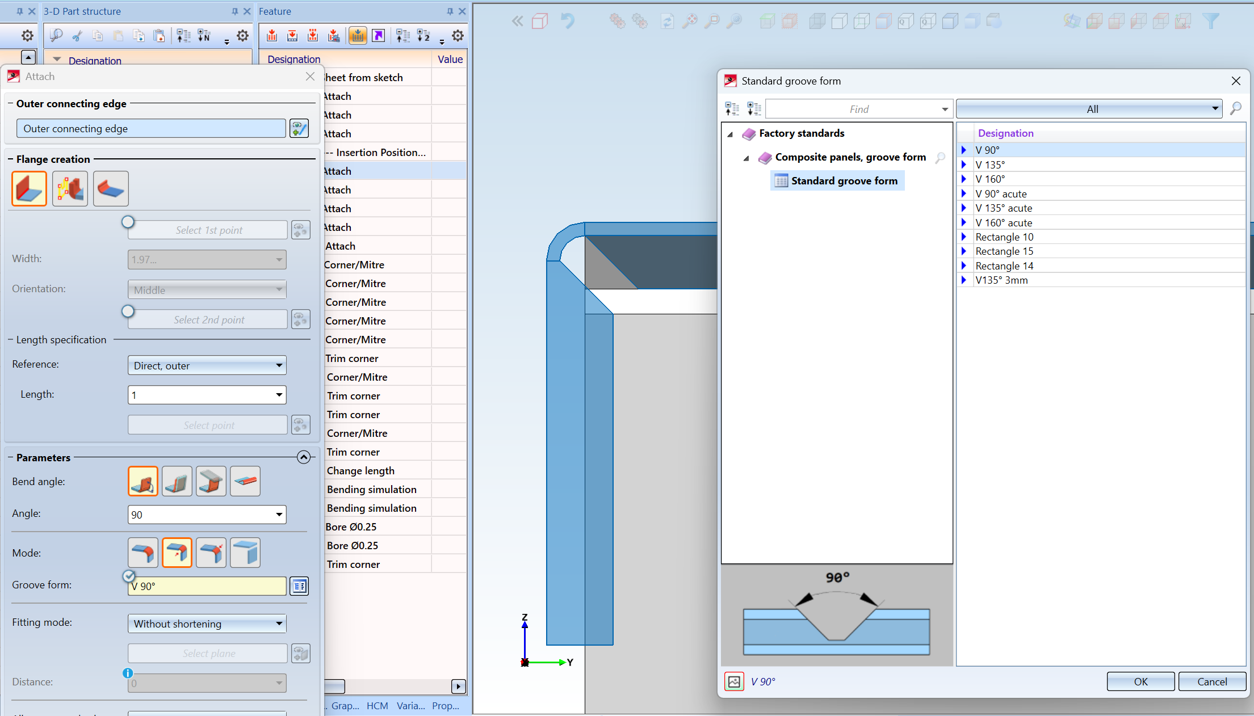
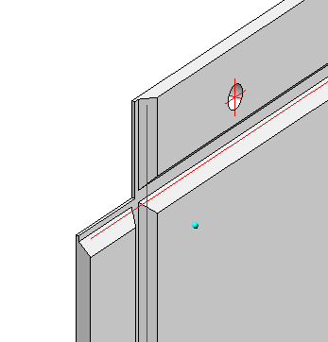
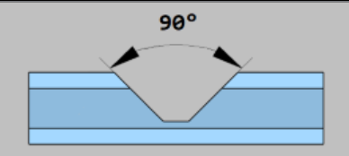
Sheetmetal and ACM: processes in detail: corners

Slide 7
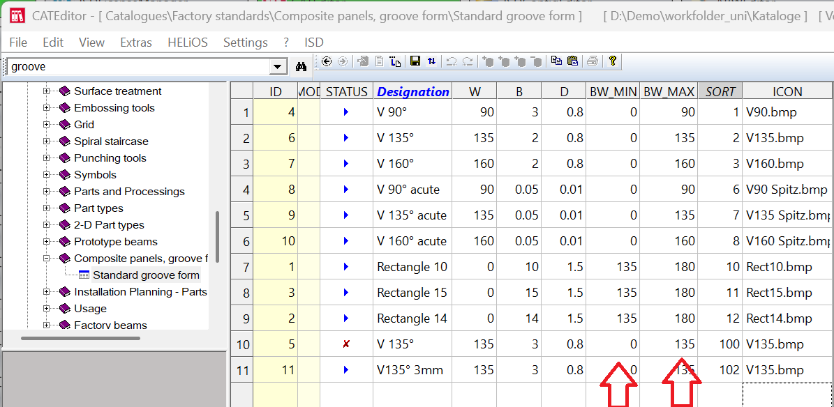
Sheetmetal and ACM: flange angle and settings specs

Slide 8
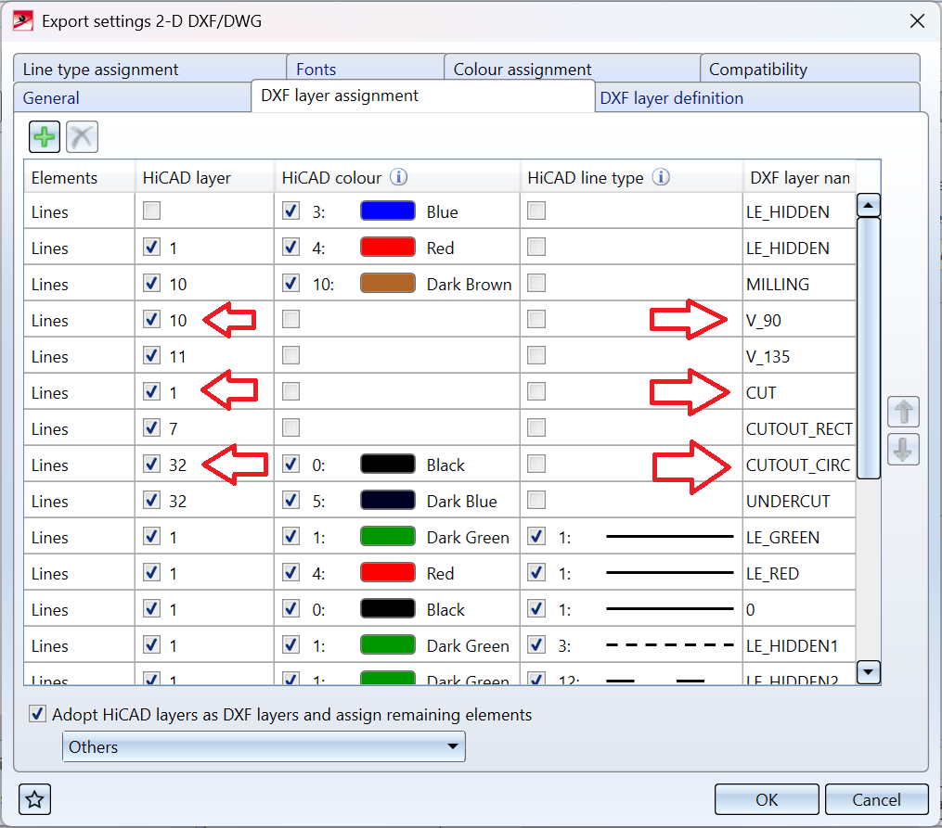
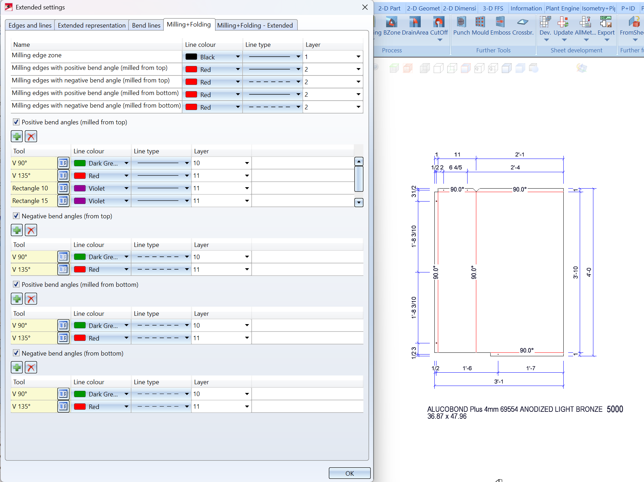
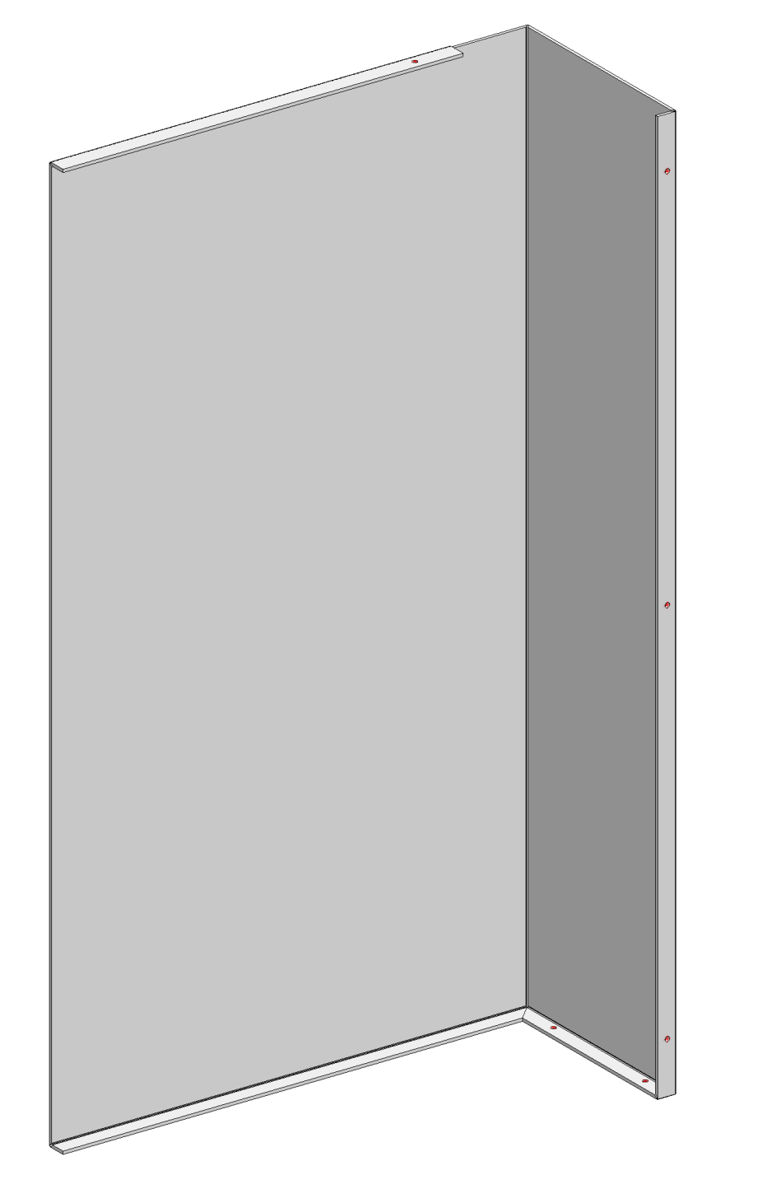
Sheetmetal and ACM: tooling and layer names for CAM

Slide 9
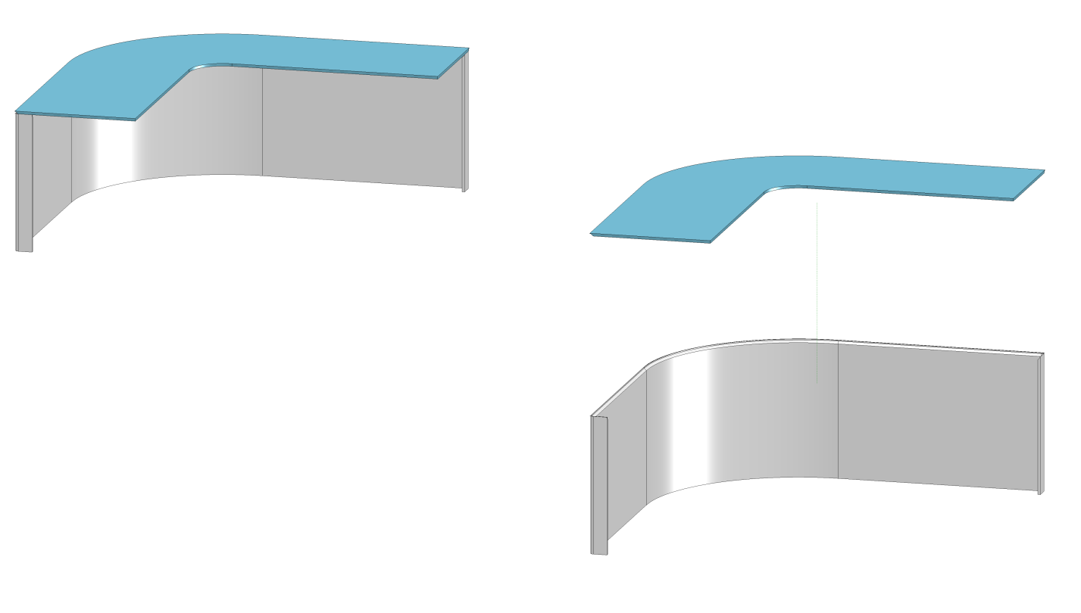
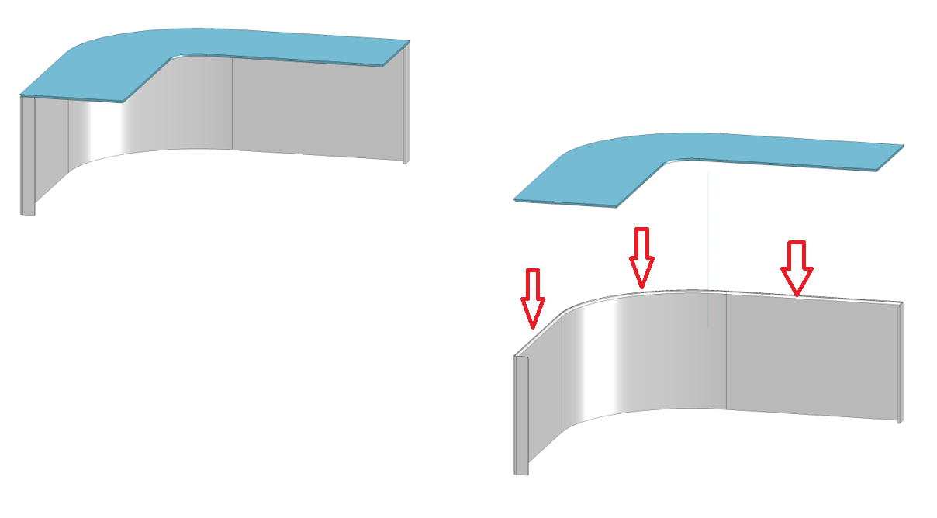
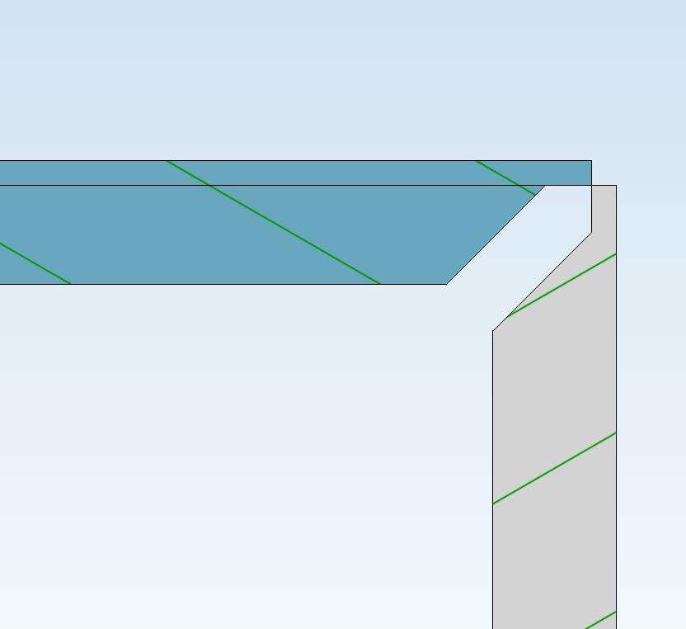
Sheetmetal and ACM: free milling edge zones

Slide 10
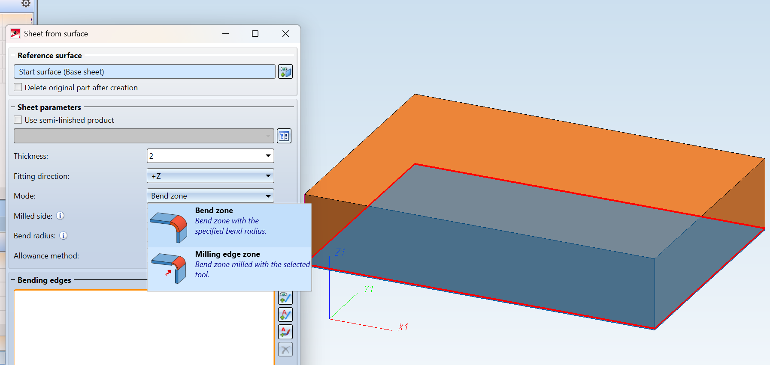
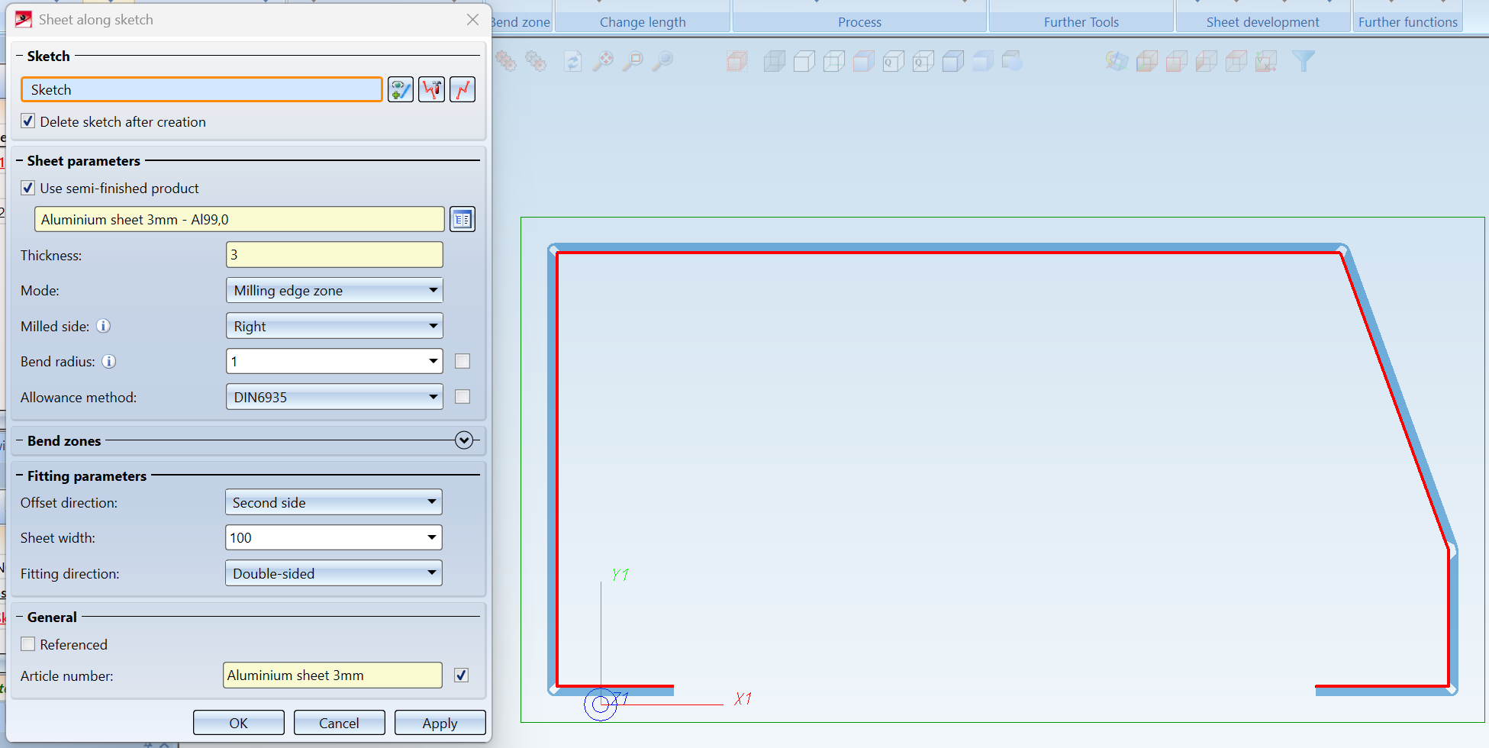
Sheetmetal and ACM: sheet along sketch/ sheet from solid etc.

Slide 11
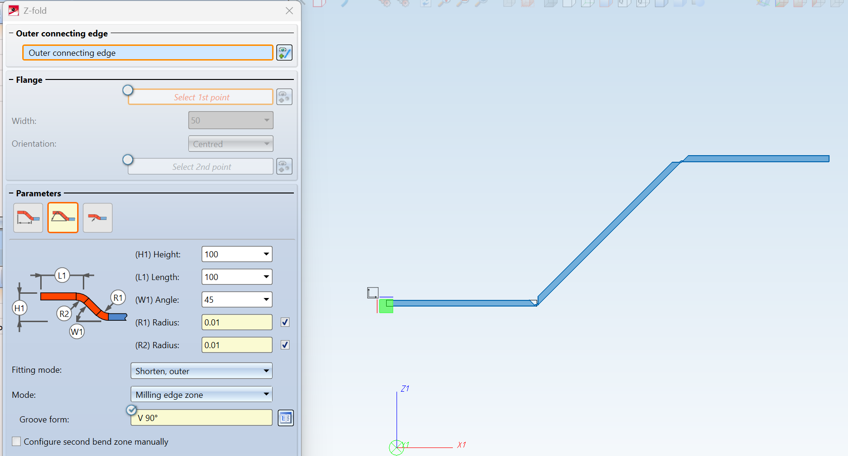
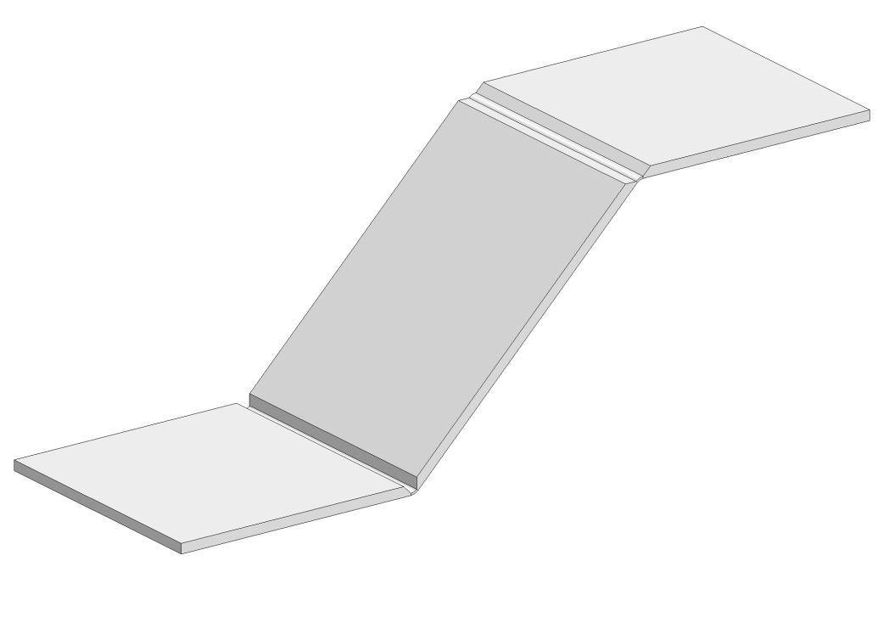
Sheetmetal and ACM: Z - fold

Slide 12

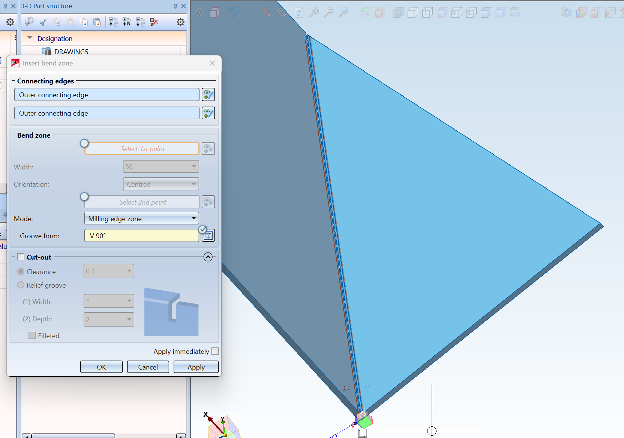
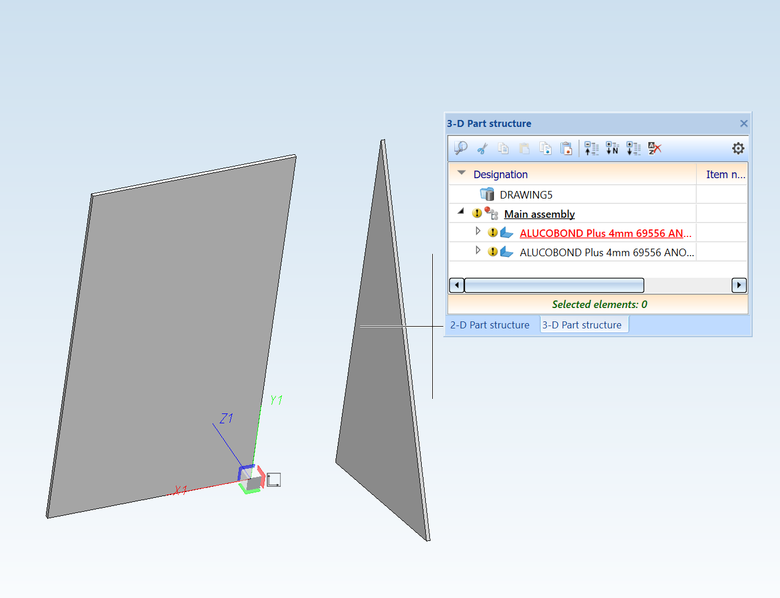
Sheetmetal and ACM: inserting milling edge grooves in complex shapes

Slide 13
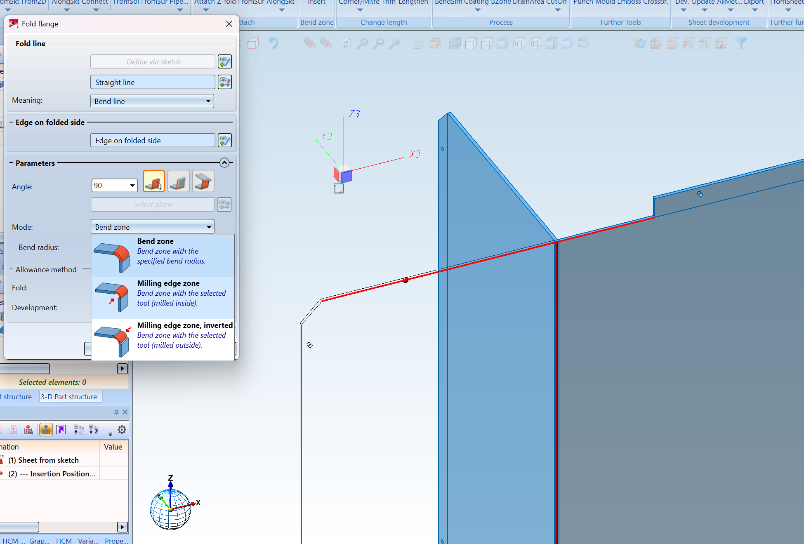
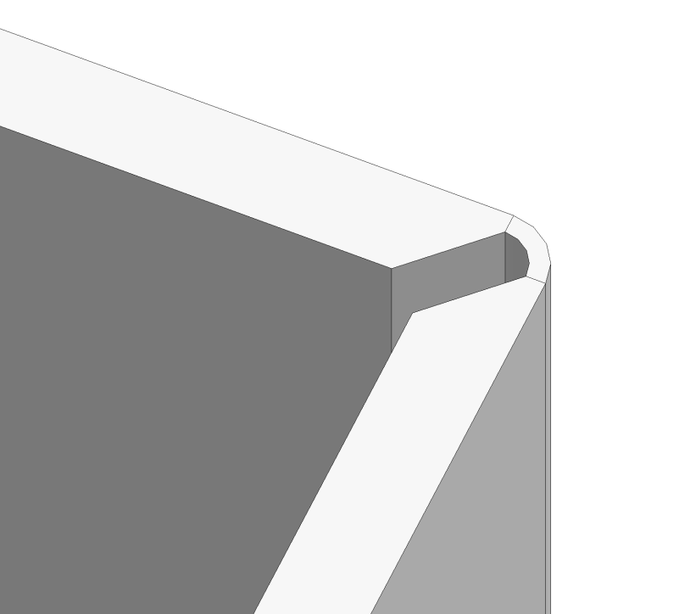
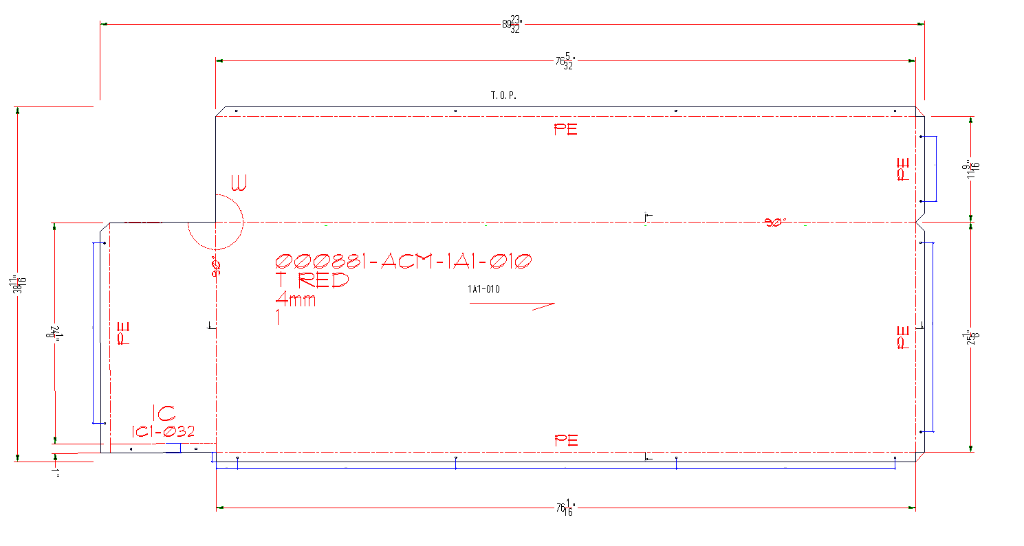
Sheetmetal and ACM: from 2D to 3D

Slide 14
BIM/ IFC

Slide 15








BIM/ IFC
data flow
planning
detail drawings
contractor
revisions
analyze
lasercutting
architects
IFC Viewer
production
BIM manager
punching
builder
merging
assembly drawing
engineering
design
design
workflow
management
visualize
press break
project manager
coordinate
production drawing
clash collision detectie
sawing machine
bill of materials

Slide 16
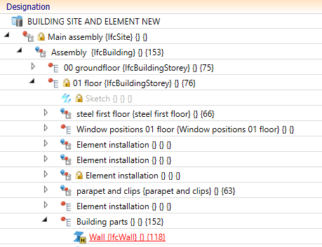
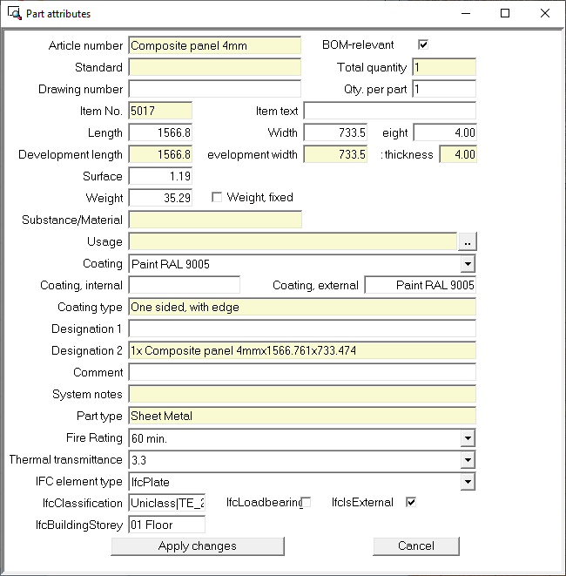
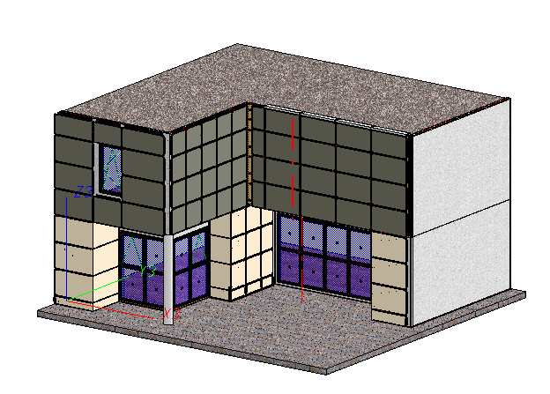
BIM/ IFC

Slide 17
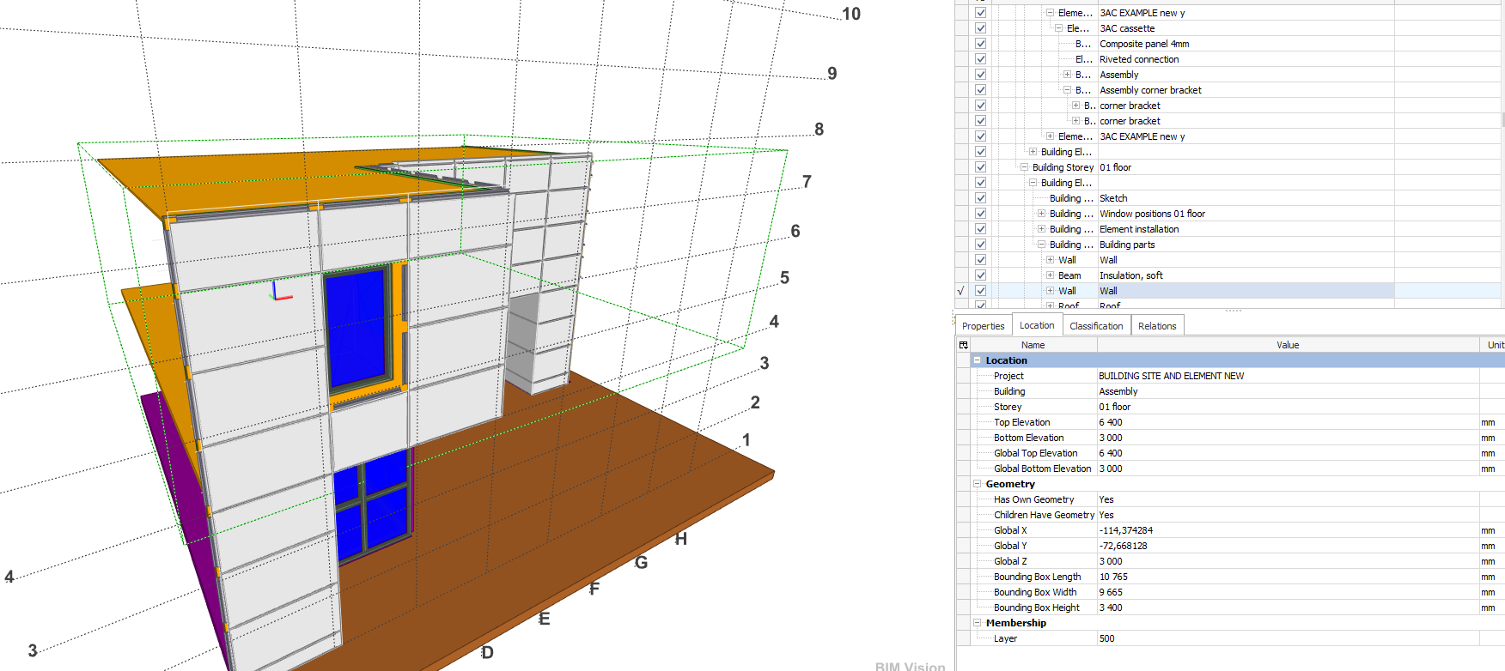
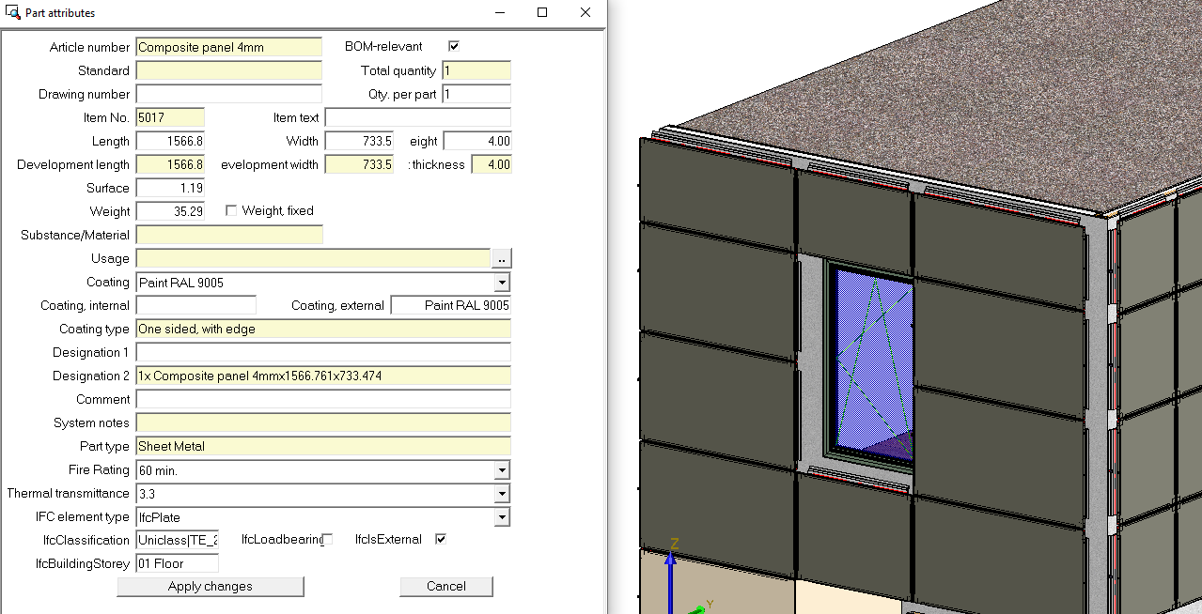
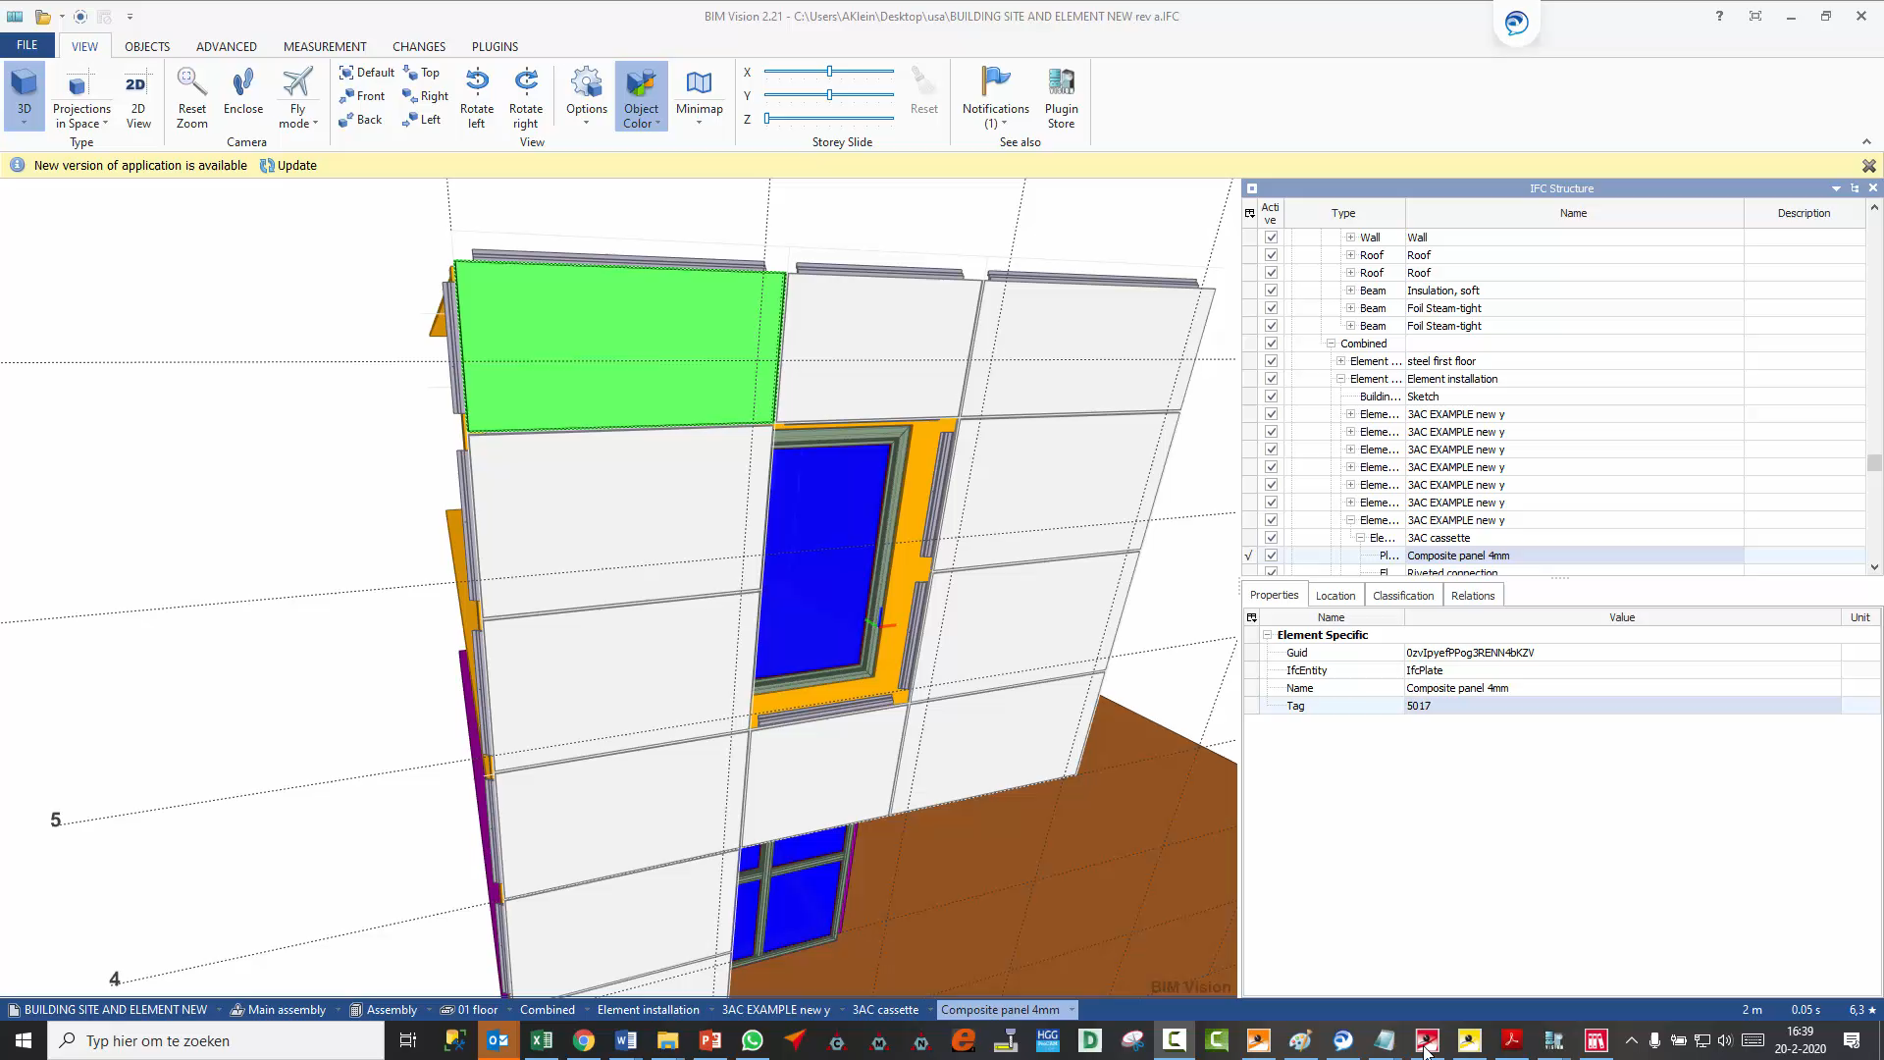
BIM/ IFC

Slide 18
Thank You

